Slide 1
Webinar#4 The EMRO Region & WTS: Highlights on Lebanon & WTS Date/Time: February 26 at 3:00 P.M Beirut Time (GMT+2) Dr. Monique Chaaya; Professor and Chair of the Department of Epidemiology & Population Health at AUB

Slide 2
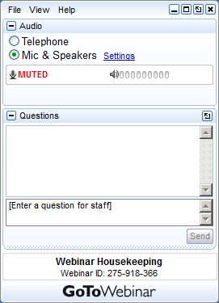
Please raise your hand to be unmuted for verbal questions or comments
Submit your questions and comments using the Questions panel

Slide 3
The EMRO Region & Waterpipe Tobacco Smoking (WTS): Highlights on Lebanon & WTS
Objectives:
Review current WTS trends in Lebanon and in the EMRO region
Speaker:
Dr. Monique Chaaya; Professor and Chair of the Department of Epidemiology & Population Health at AUB

Slide 4
Objectives of this webinar:
Review current WTS trends in the EMR region
Describe current WTS status in Lebanon
Introduction
Present and past
Factors behind its increased usage and spread
Myths/Misconception
Health effects
Global estimates and comparing EMR with other regions
Current WTS Trends in the EMR Region
Current WTS status in Lebanon
Prevalence and trends in different populations
Notes:
Initially invented in Persia by a doctor as a system which allowed smoke to be passed through water in order to be “purified”
It was perceived initially as a symbol of aristocracy and gentry.

Slide 5
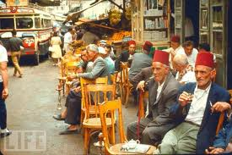
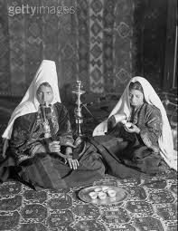
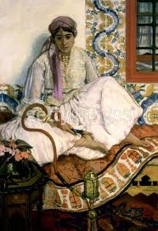
BEFORE
Notes:
Initially invented in Persia by a doctor as a system which allowed smoke to be passed through water in order to be “purified”
It was perceived initially as a symbol of aristocracy and gentry. Then it became apractice among older adult males

Slide 6
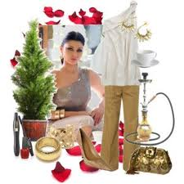
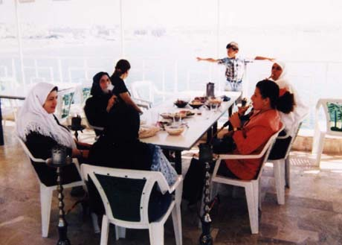
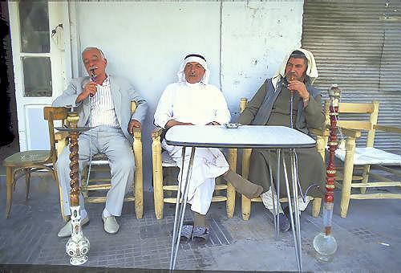
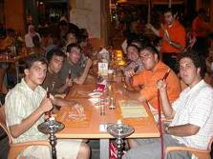
NOW A picture is worth a thousand words
Notes:
A shift in practice in mid 90’s

Slide 7
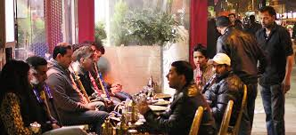
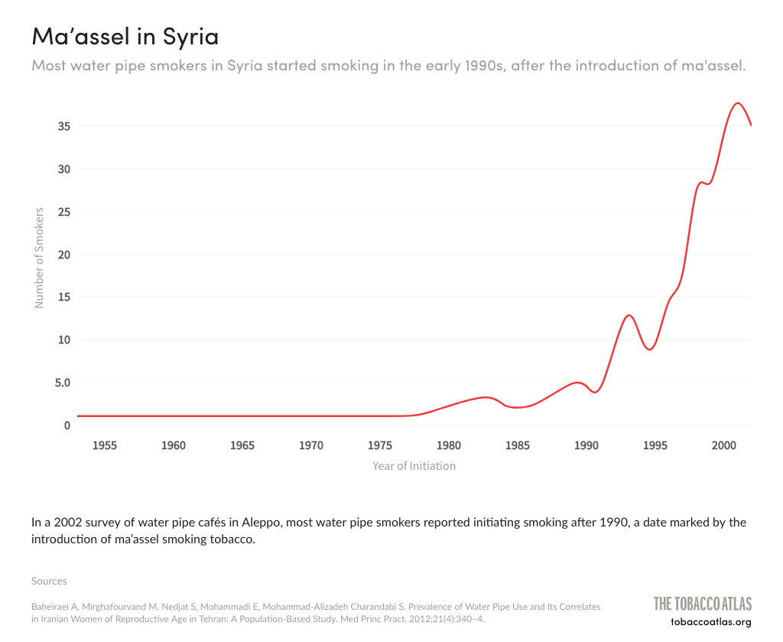
Factors behind its increased usage and spread
Socialization, relaxation, and entertainment
2. Marketing
3. The recent mass production of the flavored tobacco named ‘maassel
4. The lack of a policy framework regarding the waterpipe
5. Availability ( at home and delivery services…)
Affordability
Acceptability (among women and youth)
Notes:
Challenges in enact,ent ad enforcement of WTS legiatlation laws

Slide 8
Myths/Misconception
Myth: “The perceived less harm”: Narghileh is less dangerous than cigarette smoking because the nicotine content is lower
Myth: “The water cooling effect”: Tobacco toxins are filtered out by the water in the pipe
Myth: Fruits added to the tobacco makes Narghileh a healthy choice
Notes:
They still exist despite disseminating mnore knowledge about it

Slide 9
With evidence of toxins, it is expected that WTS affects health
(Alan Shihadeh, 2009)
Notes:
Add total increase

Slide 10
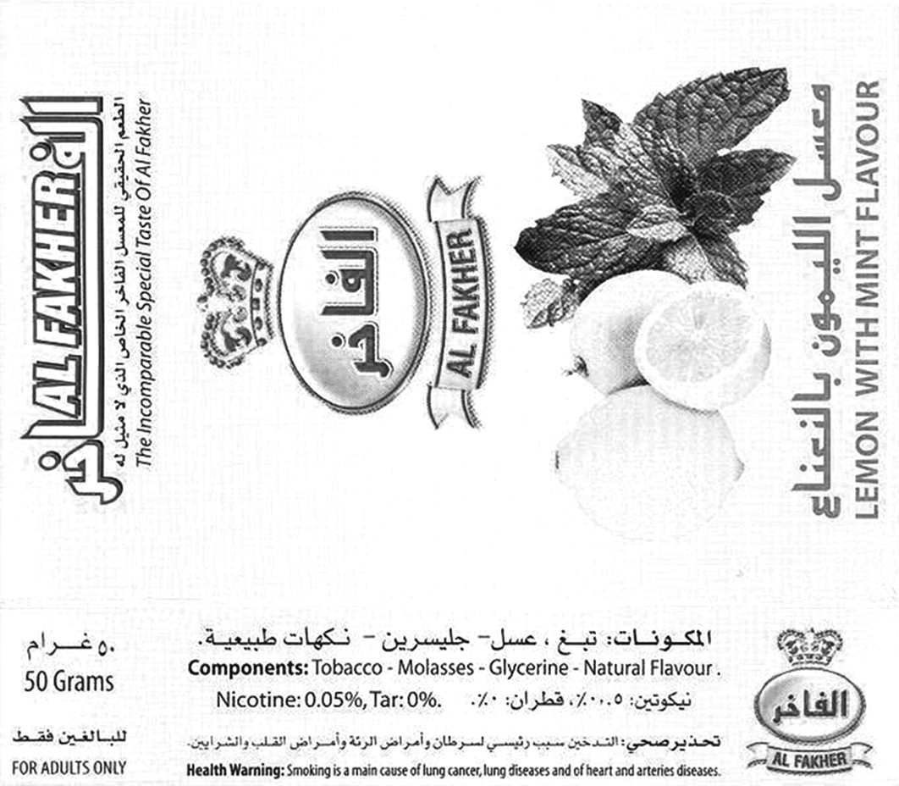
However,
Up to 77% of maassel packages, show a 0% percentage of tar.
The harm posed by smoking water pipe tobacco is deliberately misrepresented by the tobacco industry.
(Tobaccoatlas, 2019)

Slide 11
Health Effects
Evidence of Association | No Evidence of association yet
Low birthweight | Esophageal, bladder and prostate cancer
Oral cancer | Worse quality of life scores
Respiratory diseases [COPD, bronchitis] | Gastric carcinoma
Lung cancer | Hepatitis C infection
Cardiovascular disease (Coronary artery calcium and three times the risk of being in the high Coronary heart disease risk. | Periodontal disease
Metabolic syndrome | Nasopharyngeal carcinoma
Mental health | Infertility
(Waziry R, Jawad M, Ballout RA, Al Akel M, Akl EA, 2017)

Slide 12
A global epidemic among young people
From Dr. Ghazi Zaatari’s Webinar
Notes:
Prevalent in all the globe . The grey is the lack of data and not 0 prevalence

Slide 13
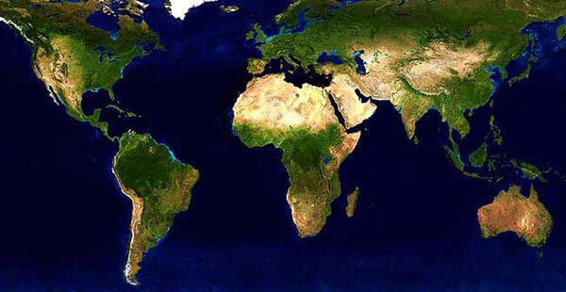
WPS: A Global Problem.
13
UK 2008(5) (8%)
Latvia 2007(3) (29.8%)
USA 2007(22) (9.5%%)
Lebanon 2007(42.5%)
Syria 2003(2) (14.5%)
Slovakia(3) 2007 (4.8%)
USA 2006(21) (20.4%)
Pakistan(19) 2008 (33.1%)
Current water-pipe smoking among adolescents in some countries
Notes:
13

Slide 14
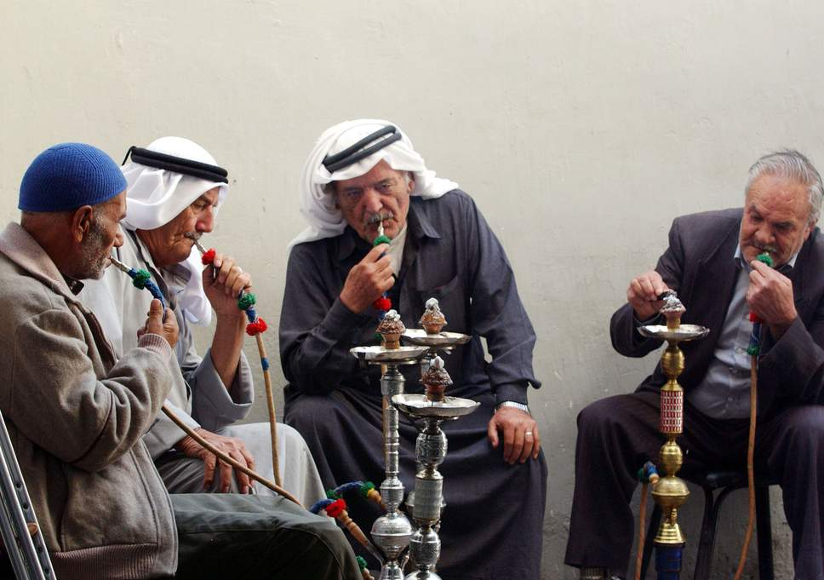
Jordanian men smoke nargile in a cafe October 22, 2002 in downtown Amman, Jordan
London , Camden Market , young boys & girls smoking at hookah shisha waterpipe narghile arghile qalyan bar cafe
Notes:
Shifting from East to west

Slide 15
Global Prevalence Estimates Africa, Americas, Eastern Mediterranean, Europe, South East Asia, Western Pacific
Among Adults
Among Youth
Highest prevalence estimates were in the Eastern Mediterranean region
Highest prevalence estimates were in both the Eastern Mediterranean and European
Mohammed Jawad, Rana Charide, Reem Waziry, Andrea Darzi, Rami A. Ballout, Elie A. Akl, 2018
Notes:
The most recent systematic review done by Jawad et al

Slide 16
Water pipe tobacco among youth in the Eastern Mediterranean Region VERSUS European region

Slide 17
Trends in Jordan and Florida
70.2 %
Jordanian Boys
61.2%
53.4%
Jordanian Girls
47.8%
43.2%
38.2%
34.4%
Florida Boys and Girls
24.1%
16.8%
18.2%
13.5%
15.8%
The Global Atlas

Slide 18
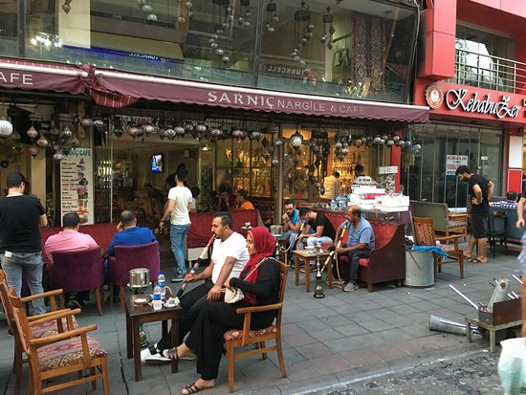
Café and restaurant culture(Hookah lounge or bar)
Appealing for tourists and young people outside
the EMR.
Benefiting largely from the weak or absent
regulatory framework.
No age restrictions
USA Example: The number of hookah cafés has
increased dramatically in the past decade,
and they are often situated around university campuses.
Denver: an increase from two in the 1990s to twenty-five cafes in 2003(Grinberg and Goodwin, 2016).

Slide 19
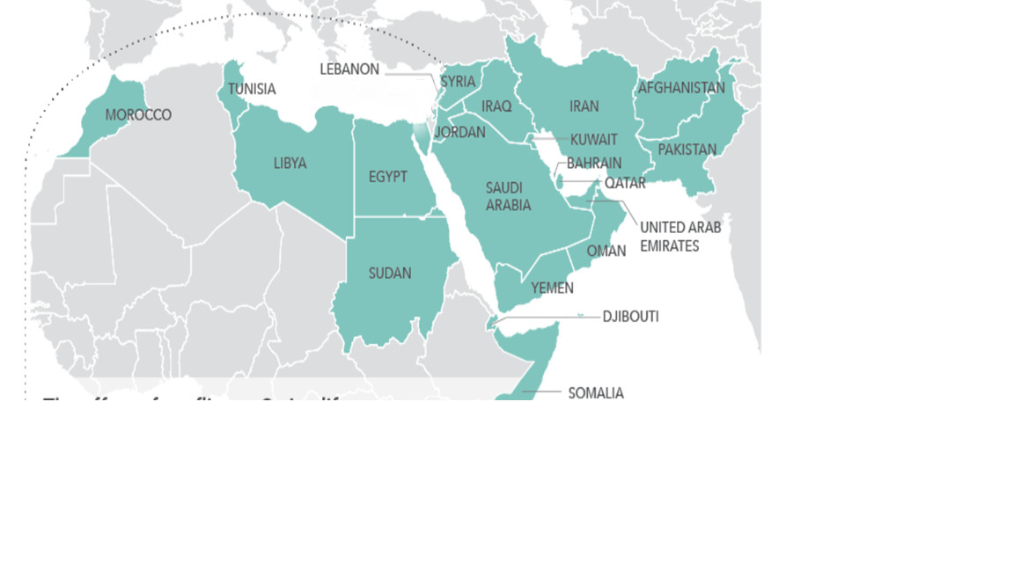
Eastern Mediterranean Region
Notes:
Zooming no on the EMR

Slide 20
Current Water pipe prevalence among youth aged 13 to 15 years
Global Youth Tobacco Survey (GYTS)
Notes:
No data on waterpipe in Afghanistan, Bahrain, Iran, Qatar, Somalia, UAE. AS you have seen before highest in Lebanon, Syria …. These data are from GYTS with different dates of the survey

Slide 21
Prevalence of Water pipe Versus Cigarettes among youth aged 13 to 15 years.
Global Youth Tobacco Survey (GYTS)
Notes:
Comparing ciagettes to wts. It is picking up ….

Slide 22
Proportion of All Tobacco Users that used Water Pipe by Sex, 2011 https://www-tandfonline-com.ezproxy.aub.edu.lb/doi/pdf/10.1080/03630242.2012.753978?needAccess=true Tobaccoatlas.org
Water pipe smoking according to gender
Notes:
Women in red and men in green

Slide 23
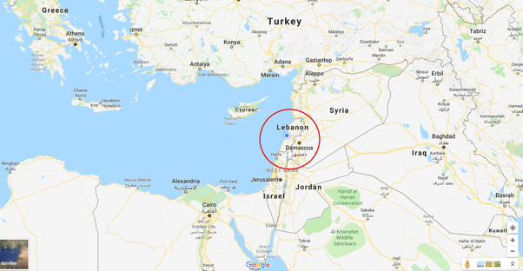
Lebanon and Water pipe Smoking
Descriptive data on:
Youth
University Students
Adults
Women
Pregnant Women
Interventions

Slide 24
Trends among youth aged 13-15( GYTS) in Lebanon
33.4%
2001
33.9%
2005
34.8%
2011
39.3% %
31%
Global Youth Tobacco Survery

Slide 25
Significant correlates of current WTS among youth:
Reduced religiosity
Peer and parent tobacco use
Recent water pipe advertisement exposure
Current cigarette use
Jawad M¹, Nakkash RT², Mahfoud Z³, Bteddini D⁴, Haddad P⁵, Afifi RA (2015)

Slide 26
Cigarette and waterpipe smoking associated knowledge and behaviour among medical students in Lebanon
Ever smoking a waterpipe was 41.9% .
Current waterpipe smoking was 29.5% (67.9% of current males, 32.2% were females)
Males were twice as likely as females to smoke waterpipes.
42.8% of waterpipe smokers believed that waterpipe smoking was more harmful than cigarette.
(Jradi H, Wewers ME, Pirie PR, Binkley PF, Ferketich K., 2013)

Slide 27
Proportion of ever water pipe smoking among university students surveyed in 1998 and 2007 by gender

Slide 28
Adults (parents)
Estimates based on a study that aimed to assess the association between Parental smoking and exposure to environmental tobacco with waterpipe smoking among youth: results from a national survey in Lebanon
Waterpipe only: 11.7%
Cigarettes and Waterpipe:32.8 %
M. Jawad, R.T. Nakkash, Z. Mahfoud, D. Bteddini, P. Haddad, R.A. Afifi(2015)

Slide 29
LEBANESE FEMALES AGED 18–65 YEARS AND WTS
Author country | Target population | Sample size | Prevalence of water pipe use in pregnancy
Daou et al (2018) Lebanon | Secondary analysis of women’s health data obtained in a national survey in 2010. | 2,255 | 78 % no or past long-term WTS 12% regular waterpipe smokers 40% light users (three waterpipe heads weekly) 60% heavy users (mean of 11 heads weekly)
Younger age, living within Greater Beirut (GB) and having skilled employment were considerably associated with use of WTS.
(Adib, S., Daou, K. and Bou-Orm, I, 2018)

Slide 30
Prevalence among pregnant women in Lebanon
Author country | Target population | Sample size | Prevalence of waterpipe use in pregnancy | Passive exposure to waterpipe
Chaaya et al (2004) Lebanon | Pregnant women presenting for prenatal care in primary care units | 864 | 23% reported smoking 17% only cigarette 4% only waterpipe 1.5% used both | 25 %
Azab et al(2012) Jordan | Pregnant women in randomly selected maternal clinic during pregnancy check-up | 500 | 8.7% waterpipe smokers during pregnancy 13% of waterpipe smokers were daily smokers | -----------
Rachidi et al. 2013 Lebanon | Women delivering in 5 university hospitals In Beirut in 2012 | 350 | 8.% of pregnant women were active waterpipe smokers | 32% Passive exposure to waterpipe and cigarette
Determinants:
Low SES and Older Age; Azab et al (2012): Lower income and older age were associated with waterpipe smoking during pregnancy.
Multiparas ;Tamim et al (2008): Multiparas were significantly more likely to smoke cigarettes and waterpipe.
Smoking partner; Yunis et al 2007

Slide 31
Examples of Interventions
One pilot intervention for pregnant women
A Randomized Controlled Trial of a Theory-Informed School-Based Intervention to Prevent Waterpipe Tobacco Smoking: Changes in Knowledge, Attitude, and Behaviors in 6th and 7th Graders in Lebanon: showed no effectiveness
RCT for smoking cessation among waterpipe smokers at AUBMC : Challemges in recruiting waterpipe only smokers
Educational material and awareness campaigns have been done with no proper evaluation

Slide 32
Prevention

Slide 33
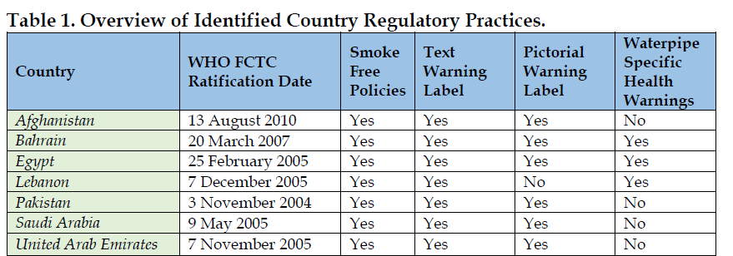
Interventions: Pictorial Warnings
Only textual warnings have been applied since 2013 on cigarette and waterpipe so far in Lebanon.
Both textual and pictorial health warnings should occupy 40% of the overall area of any tobacco pack including waterpipe, with specific text for these warnings.
WHO FCTC Secretariat’s Knowledge Hub, 2018

Slide 34
Turkey: A 65% decline in the prevalence of waterpipe tobacco smoking between 2009 and 2012
Specific health warnings concerning waterpipe to be placed on all waterpipe apparatuses
“No type of advertisement, or any type of activity whatsoever that promotes or encourages the consumption of tobacco products”
Implementing campaigns to educate the public on health hazards of waterpipe use
Preventing access to waterpipe tobacco use by youths through legislation
Mandating the placement of health warning signs in the open areas where waterpipe tobacco is served and consumed

Slide 35
Interventions: Taxation
10% increase in waterpipe tobacco taxation would reduce waterpipe tobacco demand by 14.5%.
(Mohammed Jawad, Sena Jawad, Reem K. Waziry, Rami A. Ballout, and Elie A. Akl, 2016)

Slide 36
Why is it difficult to confront water pipe use?
It often happens in homes,
Away from where traditional social pressures and policy interventions.
Tobacco Atlas

Slide 37
Concluding
Waterpipe smoking is a public health problem of large magnitude
Data on behaviors and determinants are available and contextualized
Need to plan contextualized interventions that should support a strong waterpipe tobacco control law
Thank you

